Slide 1



Data Viz

Slide 3
LME + blocking
R analysis

Slide 4


NLP
Sentiment analysis
HARPE
DATA
SCIENCE

Slide 5
Sample size?
R simulation

Slide 6
NLP basics
HARPE
DATA
SCIENCE

Slide 7
T-test
R Bootcamp
2.5

Slide 8
Regression
R Bootcamp
2.4

Slide 9
Correlation
R Bootcamp
2.3

Slide 10
Distributions
R Bootcamp
2.2

Slide 11
summarizing
data
R Bootcamp
2.1
HARPE
DATA
SCIENCE

Slide 12
HAP-E
Machine learning
concept
HARPE
DATA
SCIENCE

Slide 13
HAP-E
Stats basics
HARPE
DATA
SCIENCE

Slide 14
HAP-E
Data wrangling
HARPE
DATA
SCIENCE

Slide 15
HAP-E
Python graphs
HARPE
DATA
SCIENCE

Slide 16

HAP-E
Python setup
HARPE
DATA
SCIENCE

Slide 17
manipulating
data
R Bootcamp
1.5
HARPE
DATA
SCIENCE

Slide 18
R Bootcamp
1.4
HARPE
DATA
SCIENCE

Slide 19
R Bootcamp
1.3
HARPE
DATA
SCIENCE

Slide 20

Github
Website
HARPE
HARPE
DATA
SCIENCE
SCIENCE

Slide 21


R Bootcamp
0.0 overview
HARPE
HARPE
DATA
SCIENCE
SCIENCE

Slide 22

R Bootcamp
0.1 RStudio
HARPE
HARPE
DATA
SCIENCE
SCIENCE

Slide 23
R Bootcamp
1.1 R Syntax
HARPE
HARPE
DATA
SCIENCE
SCIENCE

Slide 24
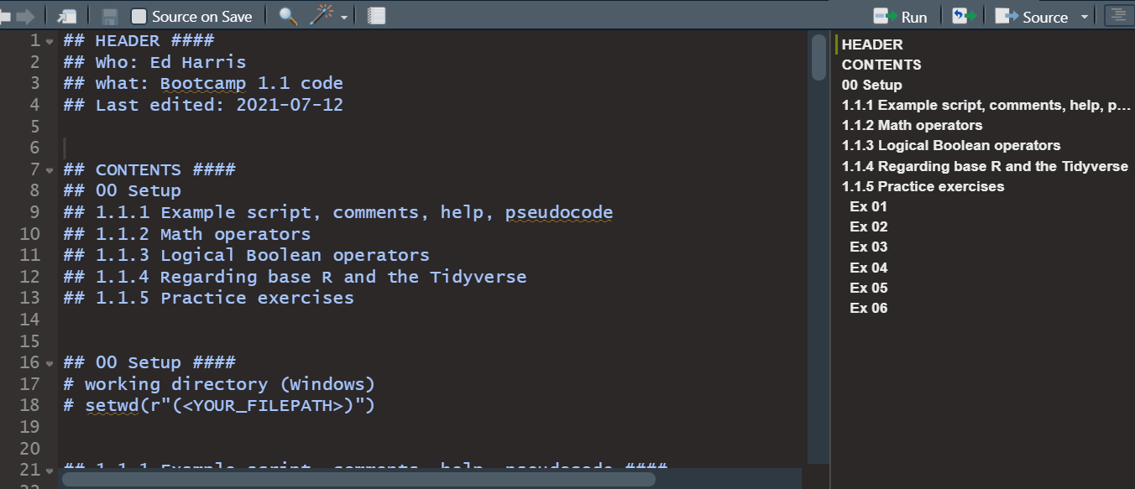
R Bootcamp
1.1 R Syntax
HARPE
HARPE
DATA
SCIENCE
SCIENCE

Slide 25
R Bootcamp
1.2 Functions
HARPE
HARPE
DATA
SCIENCE
SCIENCE

Slide 26
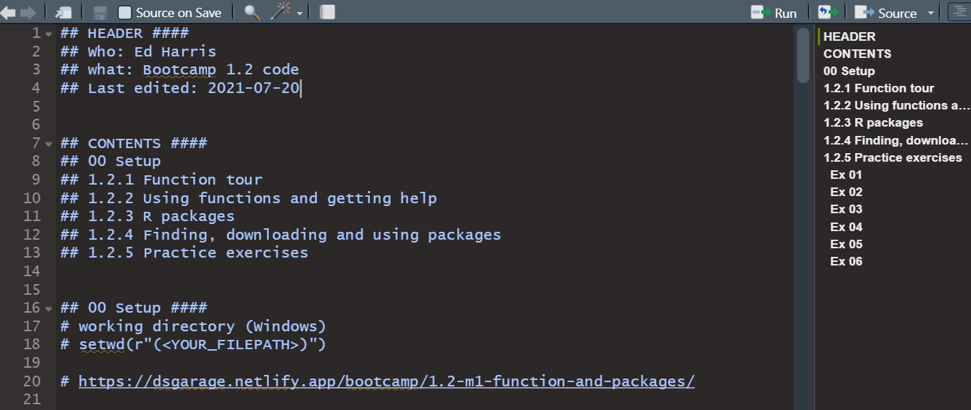
R Bootcamp
1.2 Functions
HARPE
HARPE
DATA
SCIENCE
SCIENCE

Slide 27


Q
C7081
2021
antine

Slide 28
Q
antine
Q
antine

Slide 29


HARPE
D
D
HARPE
HARPE
T
T
A
A
2021
HA UG!
D
HARPE
T
2021
A

Slide 30
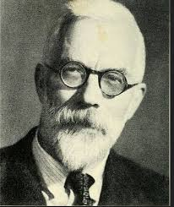

HARPE
HARPE
DATA
SCIENCE
HARPE
HARPE
DATA
SCIENCE

Slide 31


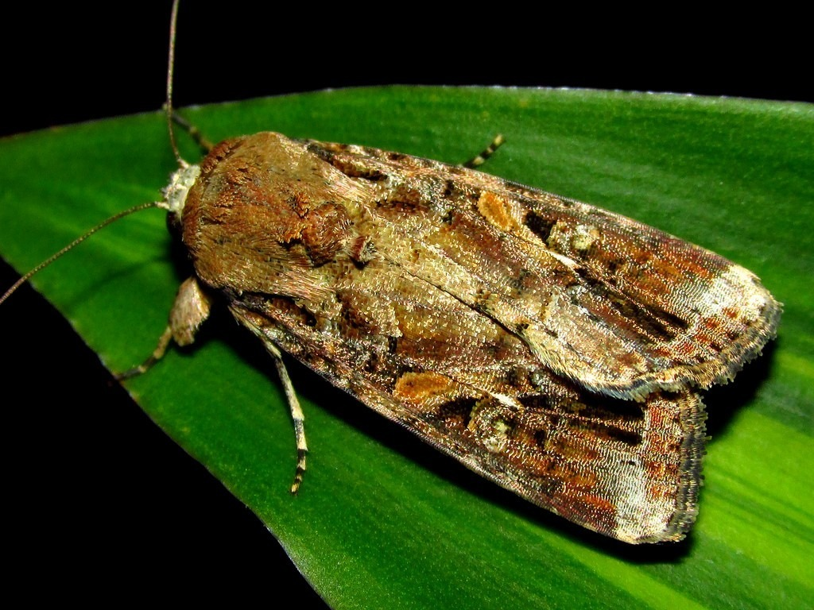






DS
EDA
2021
GA
AGE
DS
2021
DATA
SCIENCE
DS
GA
AGE

Slide 33

shinycustomloader
shinycustomloader
shinycustomloader
shinycustomloader
shinycustomloader
shinycustomloader
shinycustomloader
shinycustomloader
http://hexb.in/sticker.html

